Slide 1
Course:
Object Oriented Programming
Lecture No.02
AI-SP-26
Instructor: Mr. Abdul Baqi Malik

Slide 2

Agenda
Introduction
History
OOP Basic concepts
Concluding remarks
OOP
Objects
Classes
Inheritance
Polymorphism
Encapsulation
Abstraction

Slide 3
Introduction
  A Brief Programming History
  OOP
  Classes & Objects

Slide 4
OOP
OOP is mainly a program design philosophy.
OOP uses a different set of programming languages than old procedural programming languages (C, Pascal, etc.).
Everything in OOP is grouped as self sustainable "objects". Hence, you gain re-usability by means of four main object-oriented programming concepts.
Notes:
Which we will later discuss

Slide 5
OOP
In OOP programmers define not only the data type of a data structure, but also the types of operations/methods (functions) that can be applied to the data structure.
In this way, the data structure becomes an object that includes both data and functions (methods) in one unit. In addition, programmers can create relationships between one object and another.
For example, objects can inherit characteristics from other objects.

Slide 6
OOP
OOP
Key idea in object-oriented:
The real world can be “accurately” described as a collection of objects that interact.
Notes:
Alan Kay

Slide 7
OOP Basic Terminology
Object
- usually a person, place or thing (a noun)
Method
- an action performed by an object (a verb)
Property or attribute
- Characteristics of certain object.
Class
a category of similar objects (such as automobiles), does not hold any values of the object’s attributes/properties

Slide 8
Introduction
  A Brief Programming History
  OOP
  Classes & Objects
Notes:
I will spend more time in explaining this part as it is the core corner stone of OOP

Slide 9
Classes and Objects
A class is a prototype, idea, and blueprint for creating objects.
An object is an instance of a class.
For example, in C++ we define classes, which in turn are used to create objects
A class has a constructor for creating objects
Class is composed of three things: its name, attributes/properties, and methods.

Slide 10
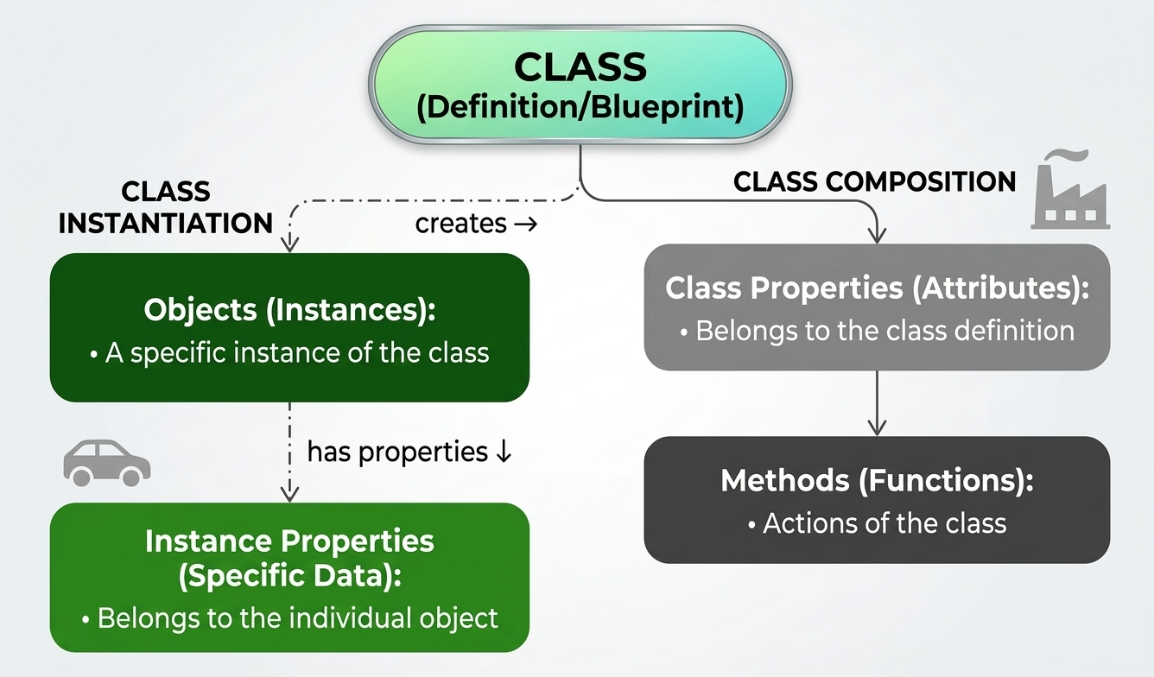
Classes (objects)
Notes:
PROPERTY
Attribute or state

Slide 11
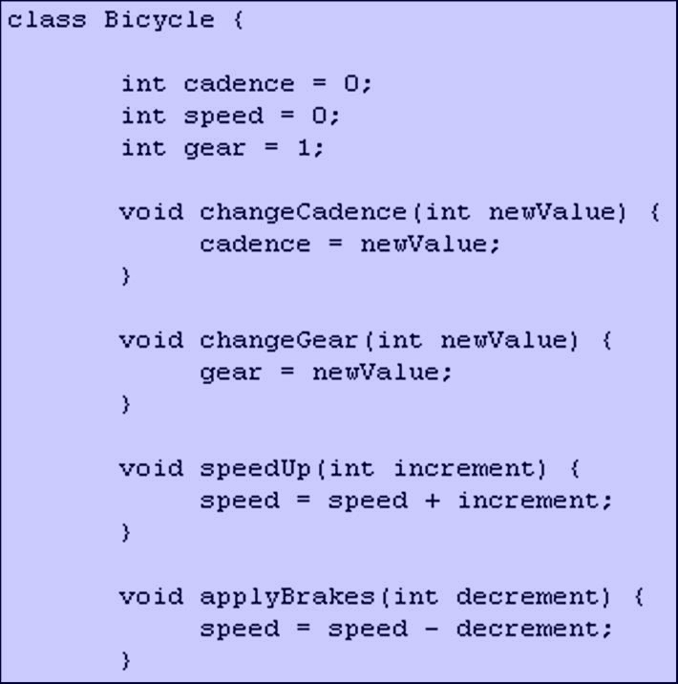
Classes & Objects
A class is a definition of objects with the same properties and the same methods.

Slide 12
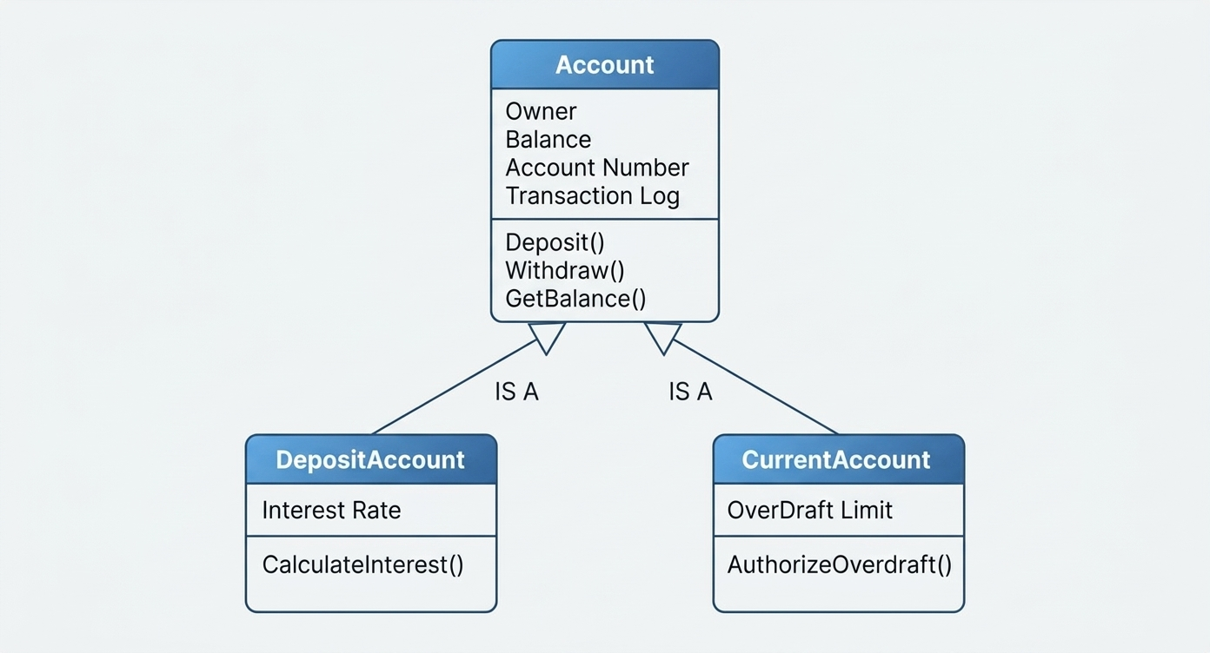
Classes Example
Notes:
http://www.eeng.dcu.ie/~ee553/ee402notes/html/figures/accountClass.gif

Slide 13
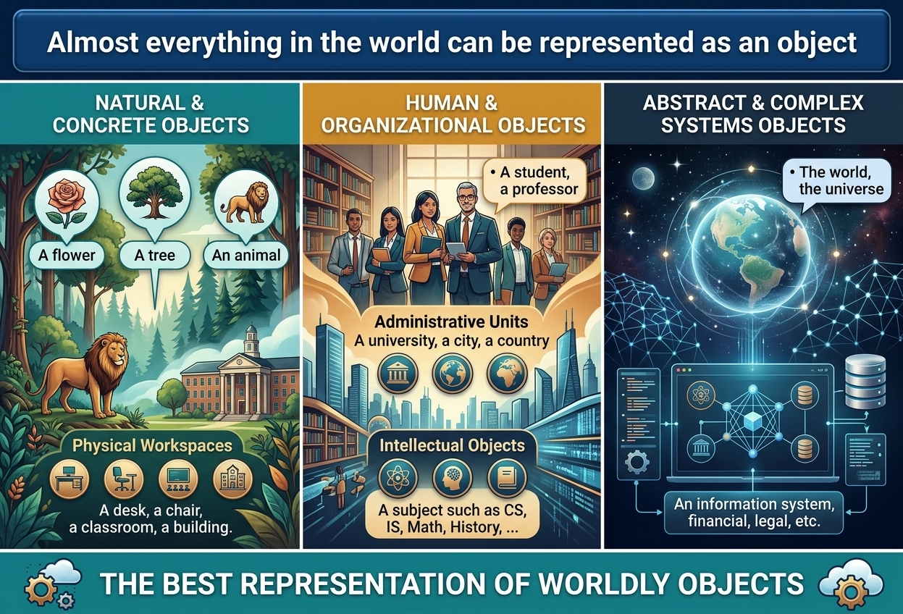

Slide 14
What is an Object, again?
An object is an instance of a class

Slide 15
More about objects
Informally, an object represents an entity, either physical, conceptual, or software.
  Physical entity
  Conceptual entity
  Software entity
Truck
Chemical Process
Linked List
Notes:
Objects allow the software developer to represent real-world concepts in their software design. These real-world concepts can represent a physical entity such as a person, truck, or space shuttle.
Objects can be concepts like a chemical process or algorithms.
Object can even represent software entities like a linked list.

Slide 16
More formal definition of an “Object”
An object is a computational entity that:
  Encapsulates some state
  Is able to perform actions, or methods, on this state
  Communicates with other objects via message passing

Slide 17
Classes & Objects
Class
CAR
“X” CAR
PROPERTY
Attribute or state
PROPERTY
Plate no:
Color:
Manufacturer:
Model:
Gear type:
PROPERTY
Plate no: AD47483
Color: Blue
Manufacturer: Mercedes
Model: CLK
Gear type: Automatic
METHOD
Do something:
function & procedure
METHOD
Moves forward
Moves backward
Moves right
Moves left
Stops
METHOD
Moves forward
Moves backward
Moves right
Moves left
Stops
Notes:
Y car is a BMW, Green, etc….
Property: Plate number, car color, number of seats
Method (function): Moving, turning right, turning left

Slide 18
Classes & Objects
class
Time
inTime
hour
minute
void addMinutes( int m )
Attributes:
hour = 8
minute = 30
Methods:
void addMinutes(int m)
outTime
Attributes:
hour = 17
minute = 35
Methods:
void addMinutes(int m)
objects

Slide 19

Class/Object
Each copy of an object from a particular class is called an instance of the class.

Slide 20

Class/Object
The act of creating a new instance of a class is called instantiation.

Slide 21
In short…
An Object is a Class when it comes alive!
Human is a class, Jawad and Jamal are objects
Animal is a class “Snowball” the cat is an object
Vehicle is a class My neighbor's BMW is an object
Galaxy is a class, the MilkyWay is an object

Slide 22
Technical contrast between Objects & Classes
CLASS | OBJECT
Class is a data type | Object is an instance of Class.
It generates OBJECTS | It gives life to CLASS
Does not occupy memory location | It occupies memory location.
It cannot be manipulated because it is not available in memory (except static class) | It can be manipulated.
Object is a class in “runtime”
Notes:
Object is a class in the runtime

Slide 23
Objects Need to Collaborate!
Objects are useless unless they can collaborate together to solve a problem.
  Each object is responsible for its own behavior and status.
  No one object can carry out every responsibility on its own.
How do objects interact with each other?
  They interact through messages.
Notes:
At this stage, we’ve discovered a number of different classes and defined these classes. However, our work has just begun. These objects need to realize the behavior specified in each use-case scenario. How is this done? The objects must collaborate together to bring about the desired behavior in the system.
Is there a mechanism that will allow these objects to work together? There is, and that mechanism is called a message.
We are working our way toward CRC cards. The goal of this slide is to make students aware that collaborations are a key part of a successful OO solution.

Slide 24
Object Interaction
Object 1
Object 2
Message
Property
Property
Method
Method
Object 3
Message
Message
Property
Method
Notes:
A method (or a member function or Sub-routine) in object-oriented programming (OOP) is a subroutine associated with an object of a class that forms its interface through which the outside members of the class (other objects) can access its private members (mainly the encapsulated data). Methods ("member functions") are similar to functions, they belongs to classes or objects and usually expresses the verbs of the objects/class. For example, an object of type Window usually would have methods open and close which do corresponding operations to the object they belong.

Slide 25
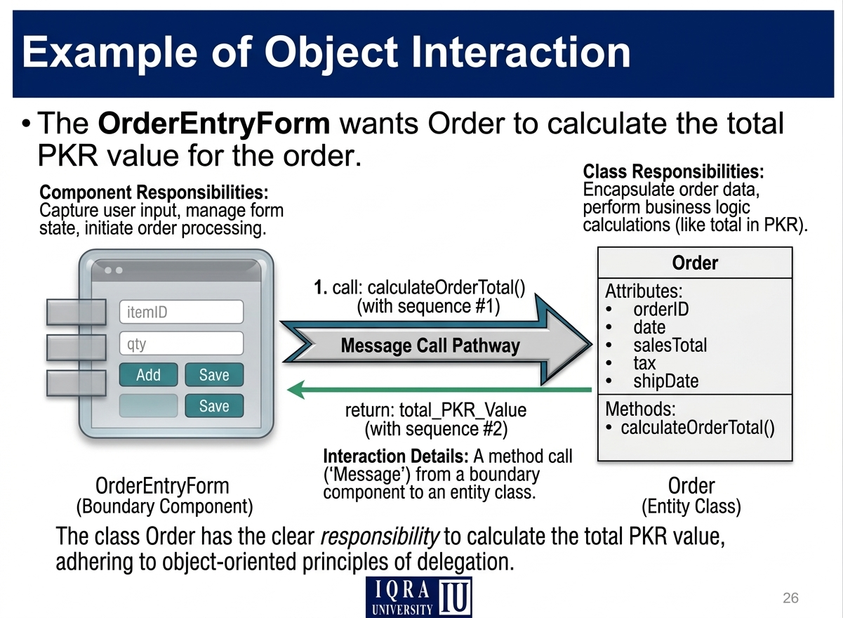

Slide 26
ANY QUESTION ??

